Slide 1
SMART DEVICE
FOR DUMB PEOPLE
DONE BY:
D.LAKSHMI SINDHURA
1602-18-735-077
P.SAHAJA
1602-18-735-092
S.VISHNUPRIYA
1602-18-735-120

Slide 2
PROJECT
DESCRIPTION
There are some situations where dumb people cannot find any medium to convey their message(ex:paper and pen). So,our aim is to design a smart device which consist of a touch screen, where the person can type in English which is converted into speech.

Slide 3
BLOCK DIAGRAM
TEXT
RASPBERRY PI ATTACHED WITH A SCREEN
SPEECH
INPUT
OUTPUT

Slide 4
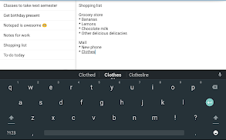
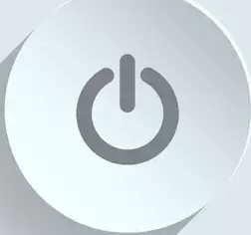
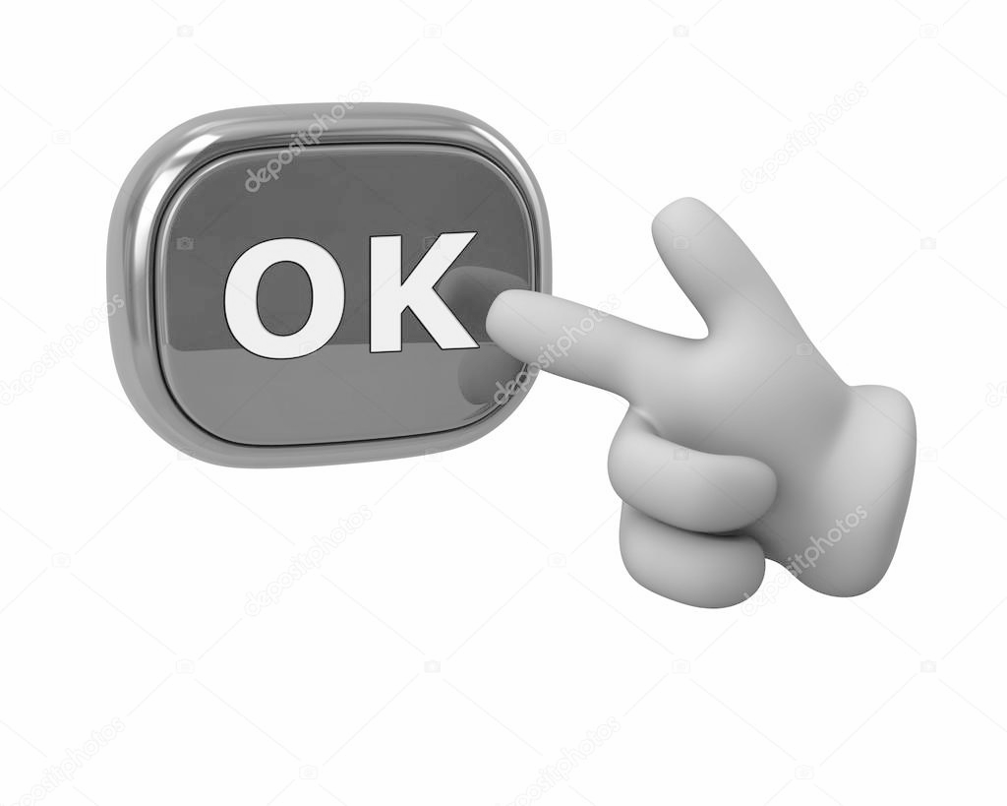
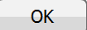

METHOD OF IMPLEMENTATION
RUN PYTHON CODE AUTOMATICALLY ON BOOT UP
COMMONLY USED WORDS:
HELLO
BYE
THANKYOU
SORRY
TYPE ANY TEXT HERE AND CLICK OK BELOW!
SWITCH ON THE RASPBERRY PI
CLICK OK AFTER TYPING TEXT
GUI ON RASPBERRY PI SCREEN
TEXT IS CONVERTED INTO AUDIO AND HEARD USING EARPHONES

Slide 5
FEASIBILITY
Hardware components required are raspberry pi, raspberry pi screen which are easily available in the market.
Softwares required are Python 3 which is open source.
Hence, it is feasible to implement.

Slide 6
PRACTICABILITY
The screen consists of commonly used commands and English keypad which is easy to use.
This device is useful to those people who know to write in a language, not only speaking.
Limitations:
Not suitable for noisy surroundings
Not applicable in rains. The device might get damaged.

Slide 7
SUSTAINABILITY
Raspberry pi screen contains an attached protective case which ensures the safety of raspberry pi. It is hard enough.
Weight of the device is about 50-60 grams and hence, is easy to wear.
There will be no heat radiations which might cause damage to the skin. So, it can be worn easily on the wrist.
The screen comes along with the protective case which is not affected by temperature and pressure.

Slide 8
SCALE OF IMPACT
There are some cases of paralysis wherein the person loses the ability to speak but still their hands will be working.In such cases, this device can help them to convey their message.
It is also beneficial to the people who lost their voice in accidents.

Slide 9
USER EXPERIENCE
Commonly used words already stored on the screen.
Easy to access because it is a GUI and displays sufficient characters at a time.
Low power consumption because only that particular keypad is opened when the device is switched on.

Slide 10
POTENTIAL FOR FUTURE WORK PROGRESSION
We can try to convert languages other than English from text to speech in future.
Possibility of adding a feature which translates the typed text to the desired language in the form of audio.
We can also add a button which increases and decreases the volume as per our requirement.

Slide 11
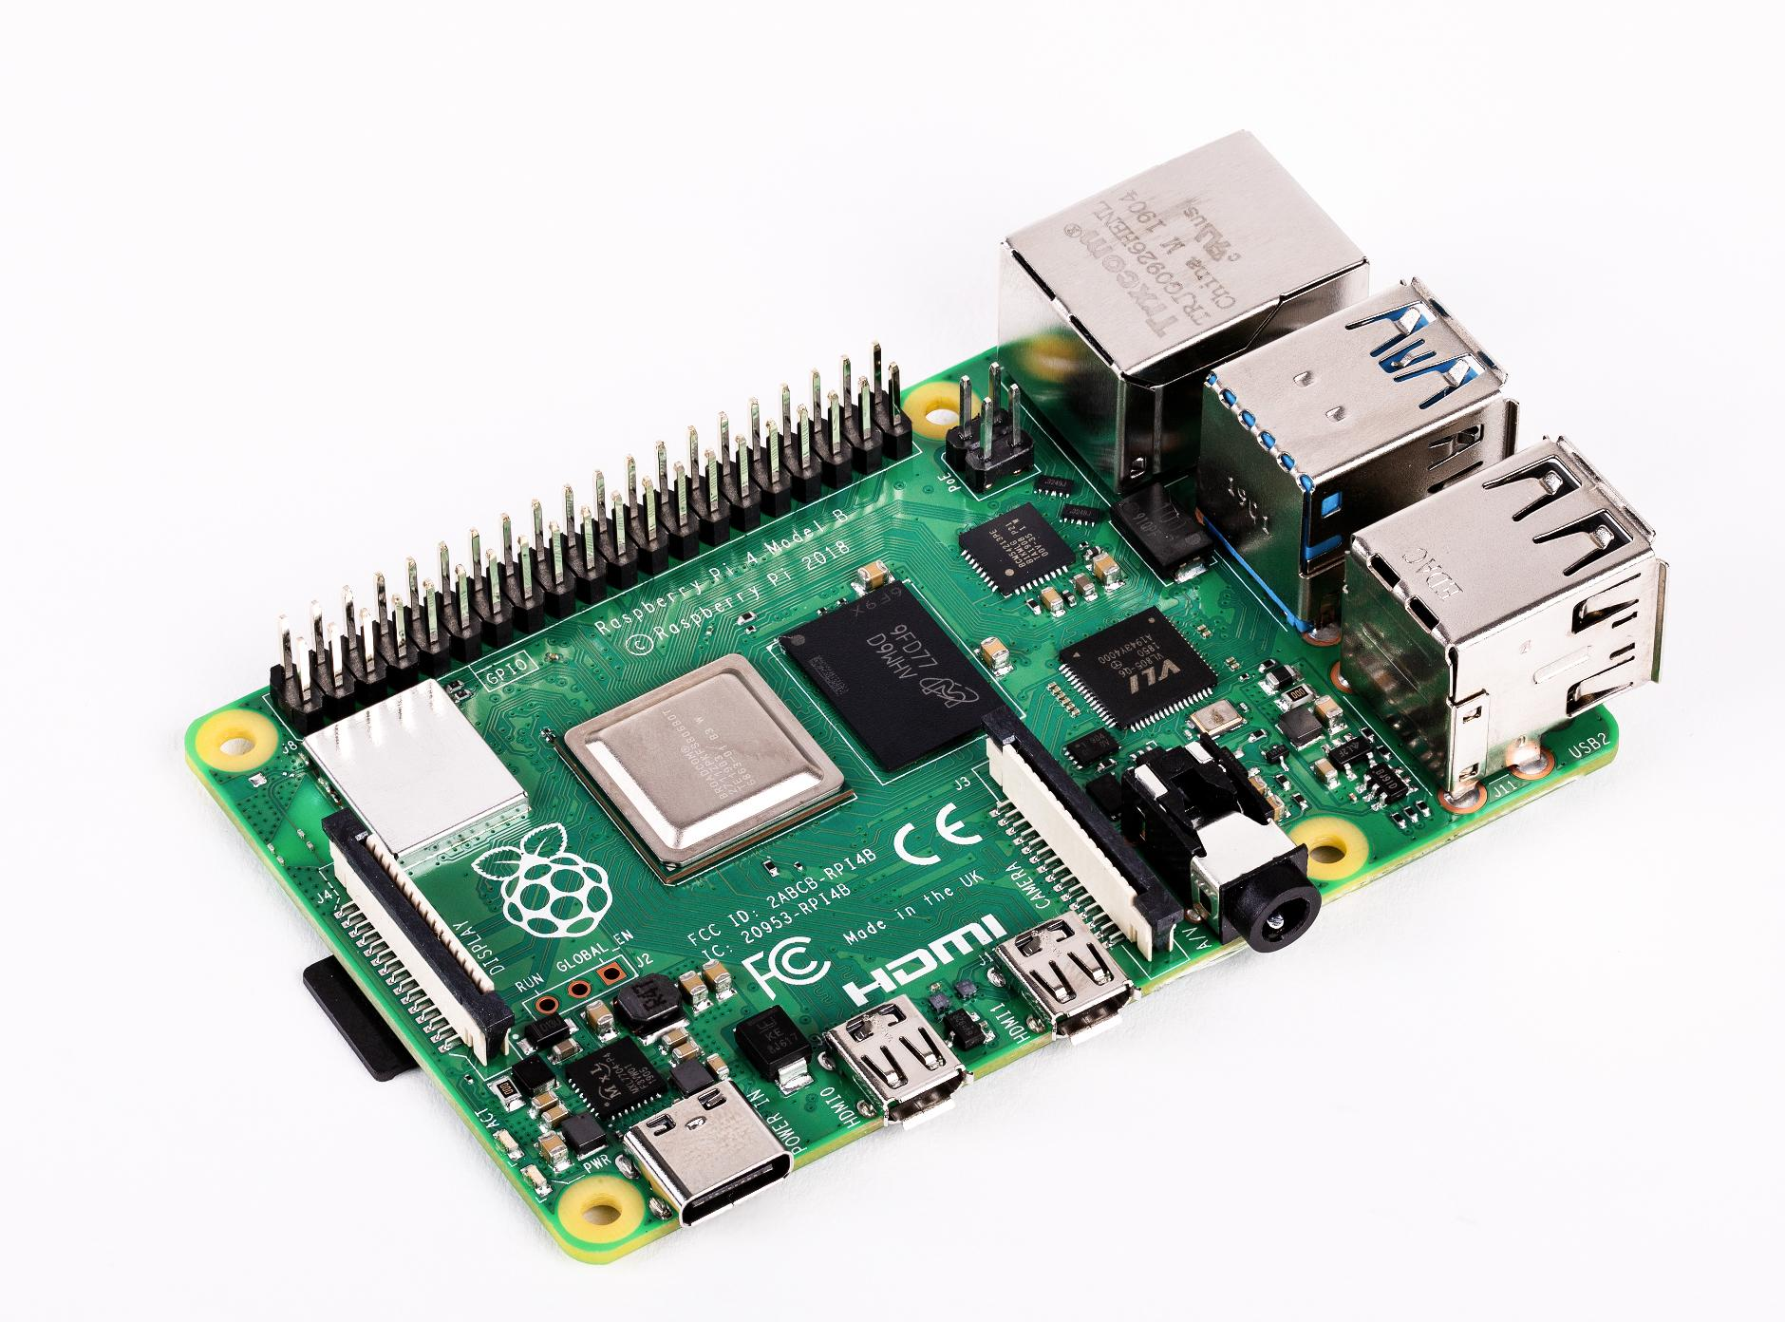
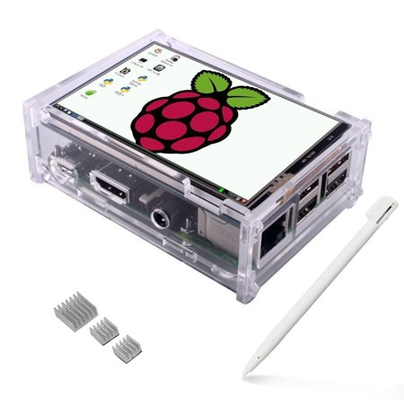
TOTAL BUDGET INVOLVED
1) RASPBERRY PI -
Rs.3500/-
2)RASPBERRY PI SCREEN -
Rs.2000/-
TOTAL BUDGET INVOLVED:
Rs. 5500/-

Slide 12
THANK YOU!

